Slide 1
Head First Docker & K8S - Part III
Evan Wang

Slide 2
Agenda
Workload Resources
Service & Ingress
Networking
Security
Storage
Scheduling
Application & Cluster Mgmt.

Slide 3
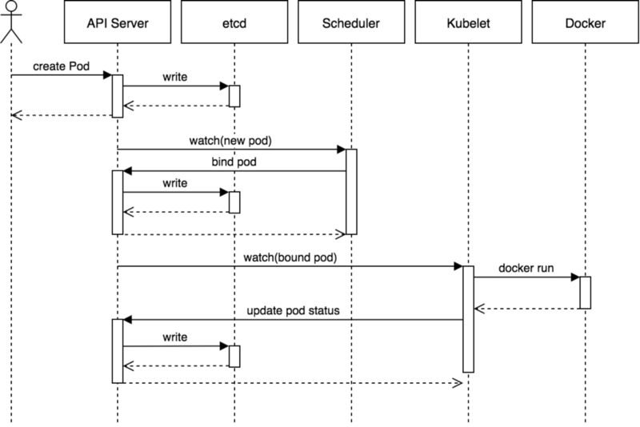
Recap – Pod Creation

Slide 4
Workload Resources

Slide 5
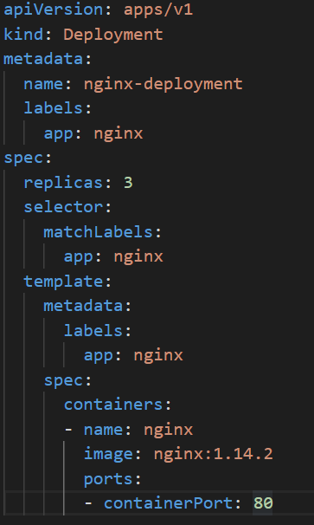
Deployment
Motivation
Pods do not self-heal
Replicas/Scaling
Rollout

Slide 6
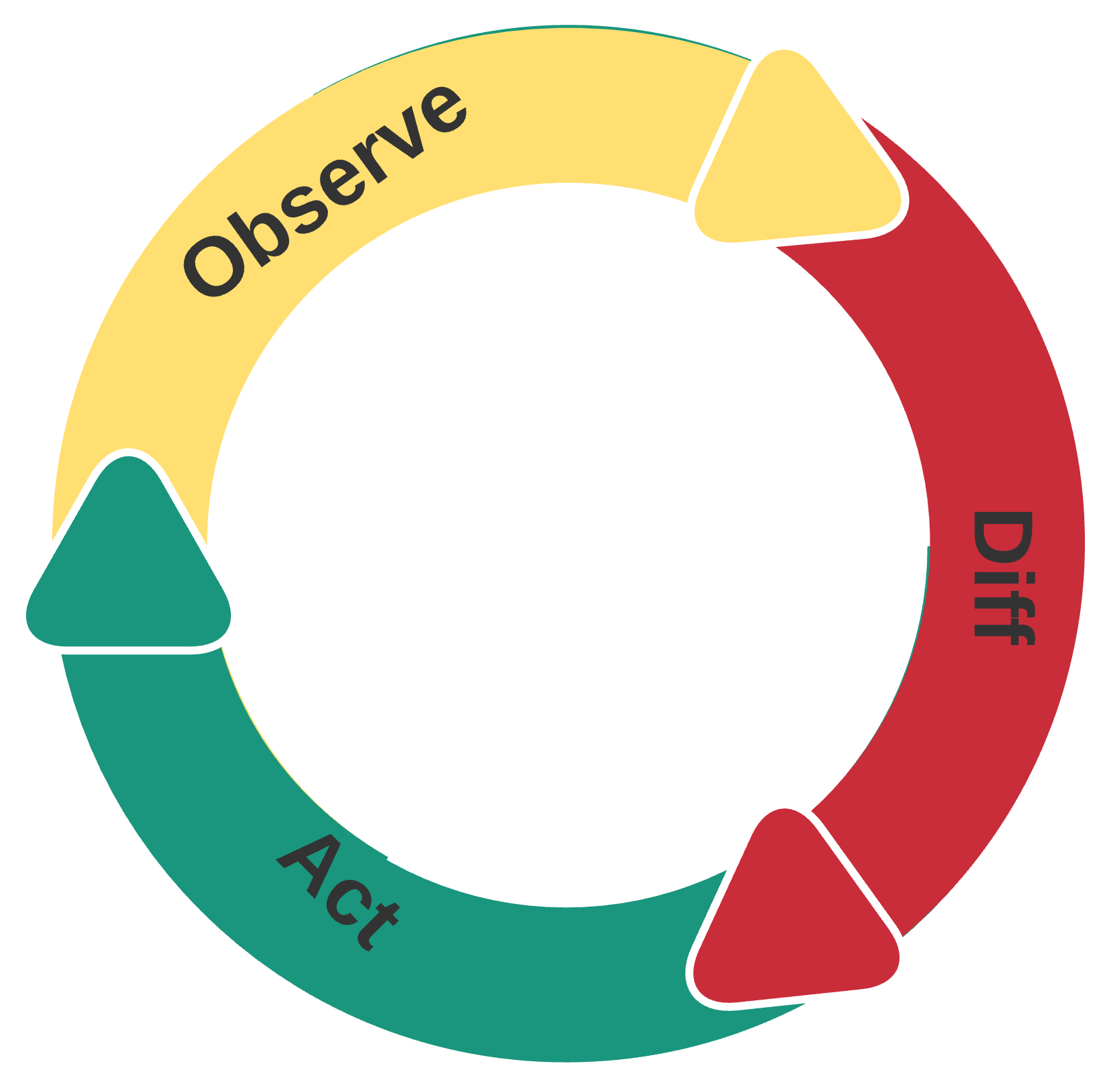
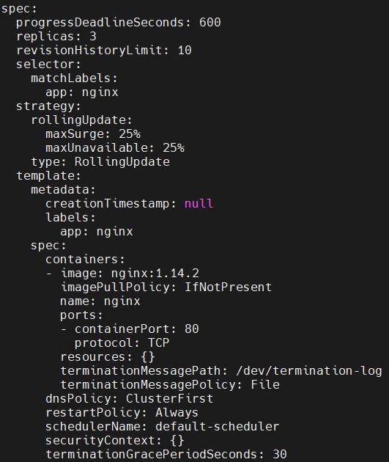
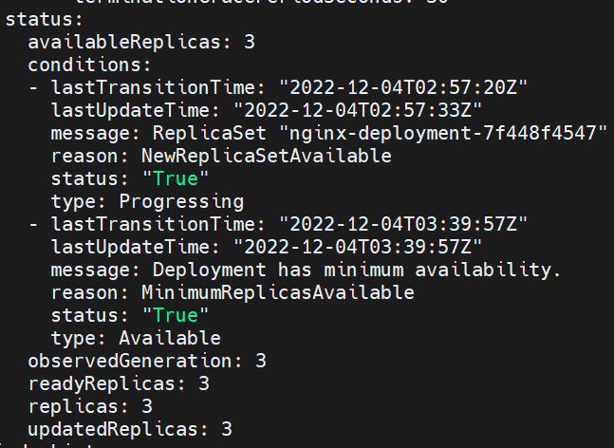
Controller Pattern
Example: AC thermostat
Control Loop
Desired State
Actual State

Slide 7
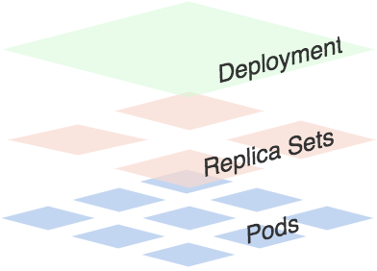
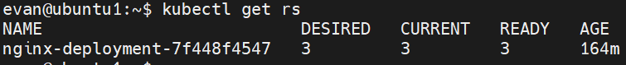
Deployment Controller

Slide 8
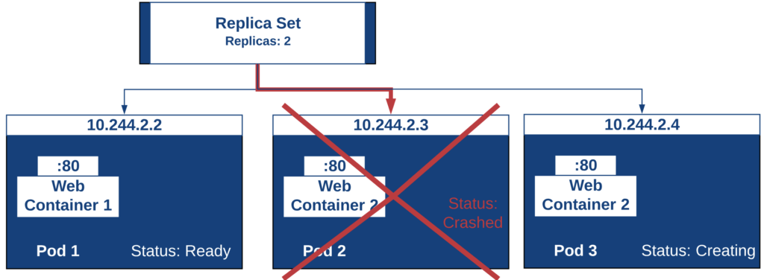
ReplicaSet Controller
Actual state change
Desired state change
Scaling

Slide 9
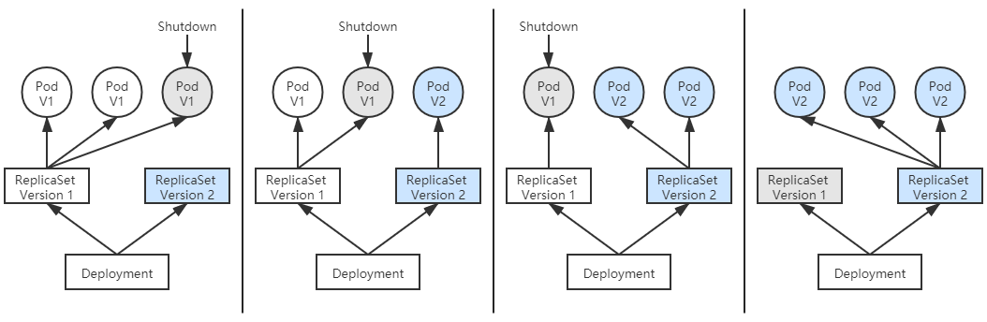
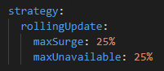
Rollout
maxSurge
Process
Settings

Slide 10
StatefulSet
Stateful Application
Stable network ID
Stable storage
Ordered pod creation and deletion

Slide 11
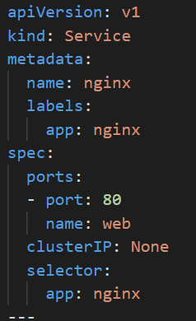
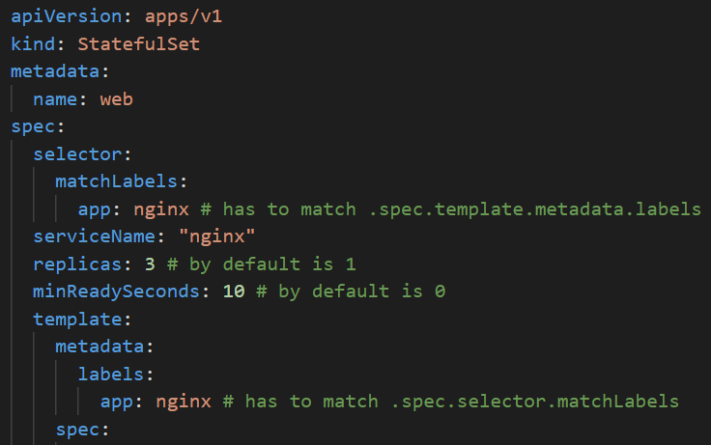
Stable Network ID
Stable Pod Hostname
$(statefulset name)-$(ordinal)
Stable Pod DNS Name using Headless service
DNS Name: $(podname).$(service name).$(namespace).svc.cluster.local
e.g. web-0.nginx.default.svc.cluster.local

Slide 12
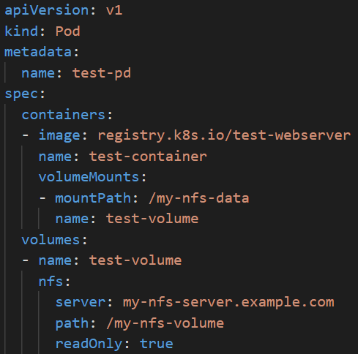
Stable Storage
Persistent Storage

Slide 13
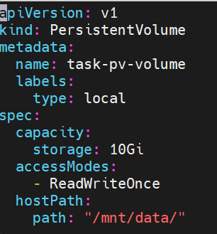
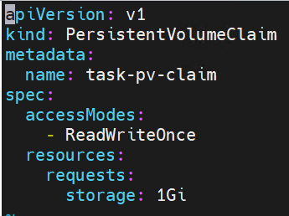
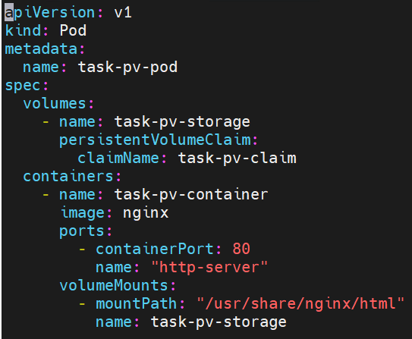
Stable Storage(cont.)
PV/PVC/Pod

Slide 14
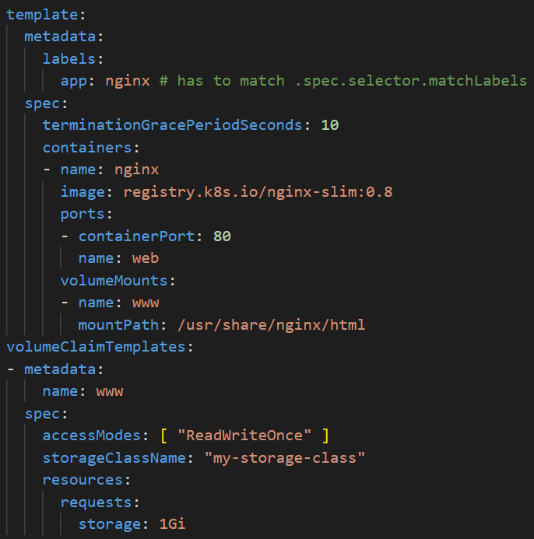
Stable Storage(cont.)

Slide 15
Ordered Pod Creation & Deletion
Deployment
Scale out/in
Rollout

Slide 16
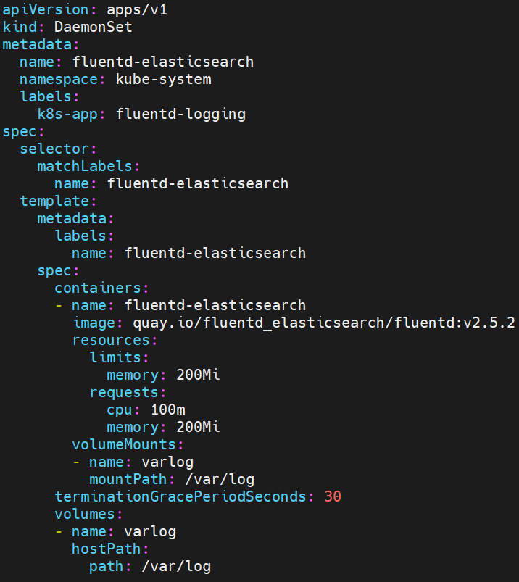
DaemonSet
Motivation:
1 pod per node
Use cases:
Storage driver
Network plugin
Log collection
Monitoring

Slide 17
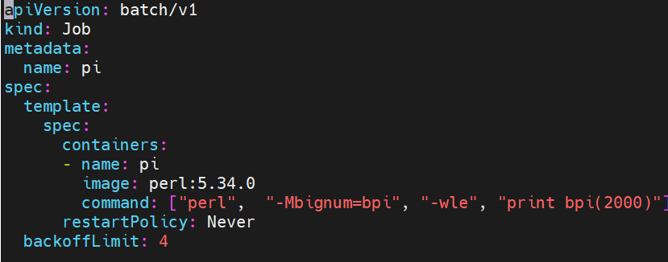
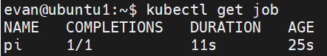
Job
One-time task

Slide 18
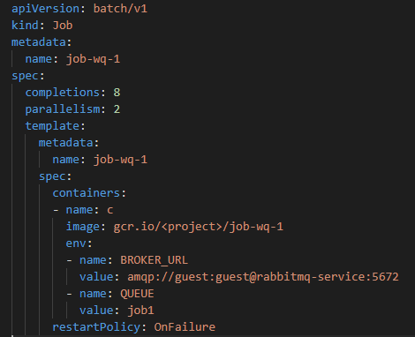
Job – Parallel Processing
Job Pattern
Job Template Expansion
Queue with Pod Per Work Item
Queue with Variable Pod Count
Indexed job with Static Work Assignment (v1.24)
Notes:
The pod index is available in the annotation batch.kubernetes.io/job-completion-index.
The control plane automatically sets the downward API to expose the index in the JOB_COMPLETION_INDEX environment variable.

Slide 19
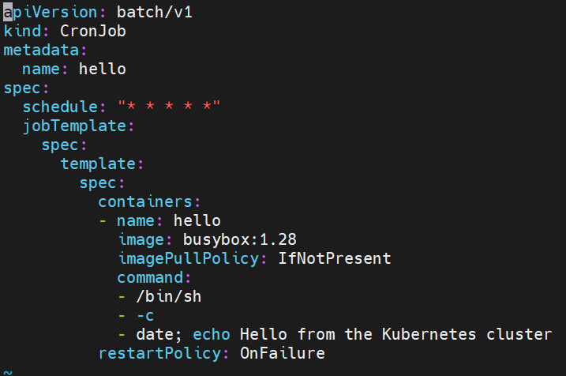
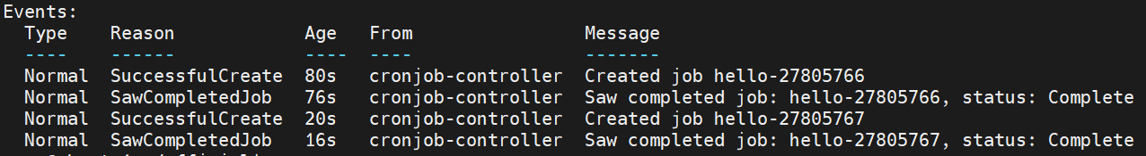
CronJob

Slide 20
Service & Ingress

Slide 21
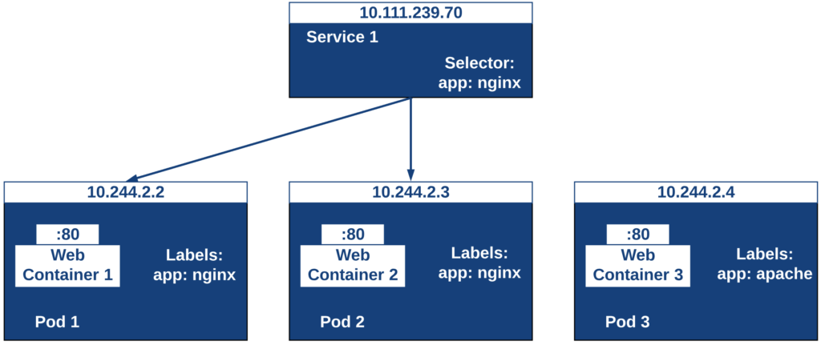
Service
Why Need Service
Service discovery
Load balancing
What’s a Service
Notes:
canary deployment: svc select stable & canary deployment by label

Slide 22
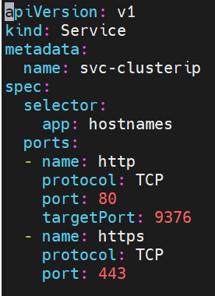
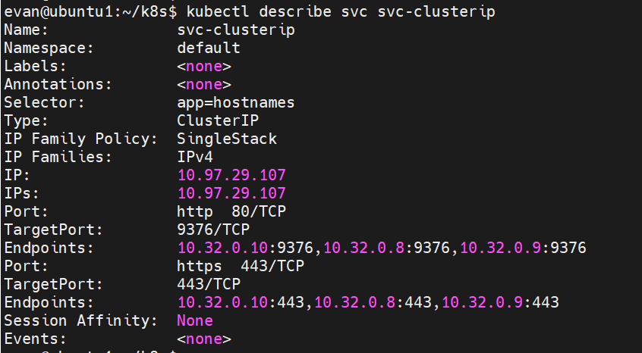
ClusterIP Service

Slide 23
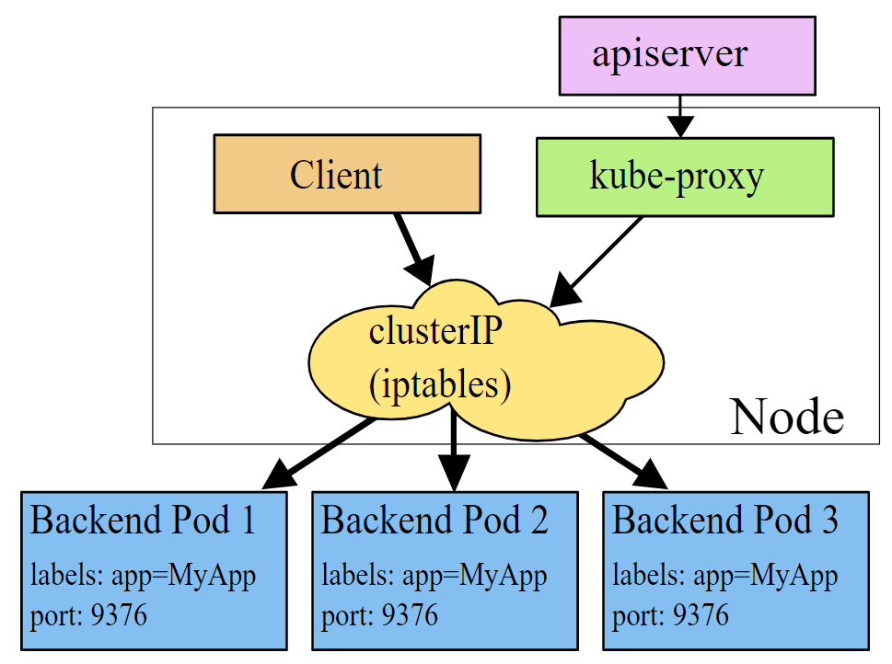
ClusterIP Service - Behind the Scenes
iptables mode

Slide 24
kube-proxy iptables mode
OUTPUT chain in NAT table
-A KUBE-SERVICES -d 10.96.85.43/32 -p tcp -m comment --comment "default/svc-hostnames:default cluster IP" -m tcp --dport 80 -j
KUBE-SVC-GU3GBXNFZE4JG5RK
-A KUBE-SVC-GU3GBXNFZE4JG5RK -m comment --comment "default/svc-hostnames:default -> 10.32.0.10:9376" -m statistic --mode random --probability 0.33333333349 -j KUBE-SEP-F7TA6HRSJAUGU7ZD
-A KUBE-SVC-GU3GBXNFZE4JG5RK -m comment --comment "default/svc-hostnames:default -> 10.32.0.8:9376" -m statistic --mode random --probability 0.50000000000 -j KUBE-SEP-IMKURALQ5KO7RMGT
-A KUBE-SVC-GU3GBXNFZE4JG5RK -m comment --comment "default/svc-hostnames:default -> 10.32.0.9:9376" -j KUBE-SEP-LX6JFFKMDGWPKSHT
-A KUBE-SEP-F7TA6HRSJAUGU7ZD -p tcp -m comment --comment "default/svc-hostnames:default" -m tcp -j DNAT --to-destination 10.32.0.10:9376
-A KUBE-SEP-IMKURALQ5KO7RMGT -p tcp -m comment --comment "default/svc-hostnames:default" -m tcp -j DNAT --to-destination 10.32.0.8:9376
-A KUBE-SEP-LX6JFFKMDGWPKSHT -p tcp -m comment --comment "default/svc-hostnames:default" -m tcp -j DNAT --to-destination 10.32.0.9:9376

Slide 25
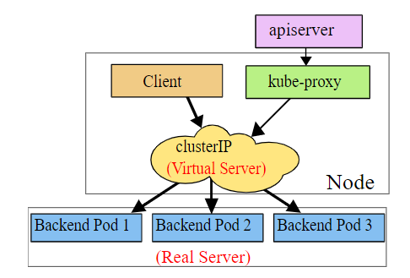
kube-proxy IPVS mode
# ip addr
...
73: kube-ipvs0: <BROADCAST,NOARP> mtu 1500 qdisc noop state DOWN qlen 1000
link/ether 1a:ce:f5:5f:c1:4d brd ff:ff:ff:ff:ff:ff
inet 10.102.128.4/32 scope global kube-ipvs0
valid_lft forever preferred_lft forever
# ipvsadm -ln
IP Virtual Server version 1.2.1 (size=4096)
Prot LocalAddress:Port Scheduler Flags
-> RemoteAddress:Port Forward Weight ActiveConn InActConn
TCP 10.102.128.4:3080 rr
-> 10.244.0.235:8080 Masq 1 0 0
-> 10.244.1.237:8080 Masq 1 0 0

Slide 26
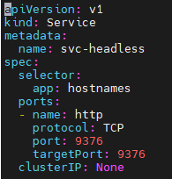
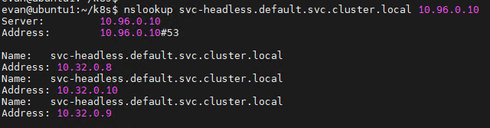
Headless Service
What’s a headless service
Use case
Access a pod using fixed DNS name
Access pods in StatefulSet via pod DNS name
Access master in Mysql cluster via service DNS name
Caller needs all Pod IPs (e.g. do monitoring or do LB itself)
Notes:
Question: Can ClusterIP service be accessed from outside of K8S cluster?

Slide 27
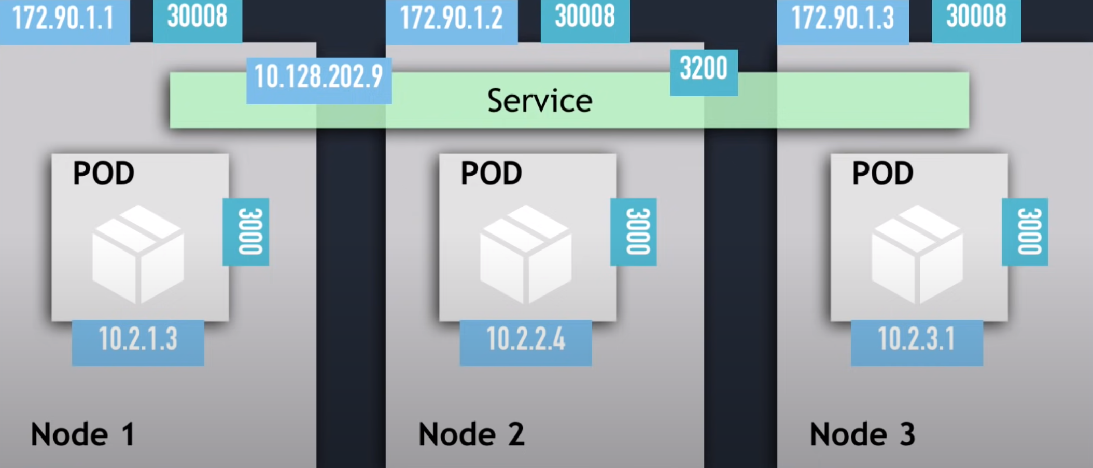
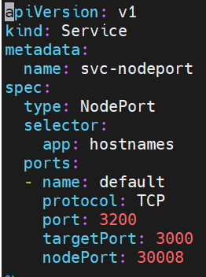
NodePort Service

Slide 28
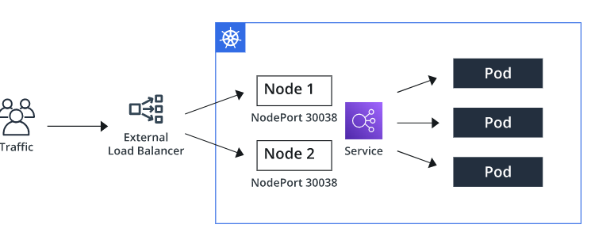
Load Balancer Service
Notes:
Demo

Slide 29
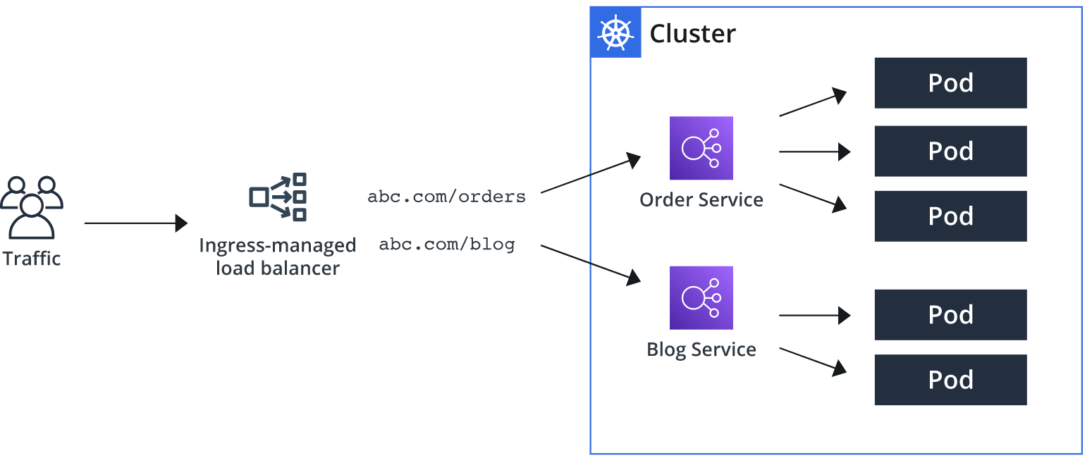
Ingress
Notes:
Motivation: cost & mgmt. efforts of multiple LBs

Slide 30
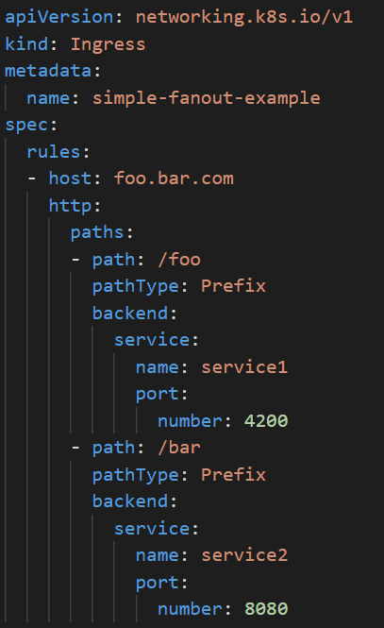
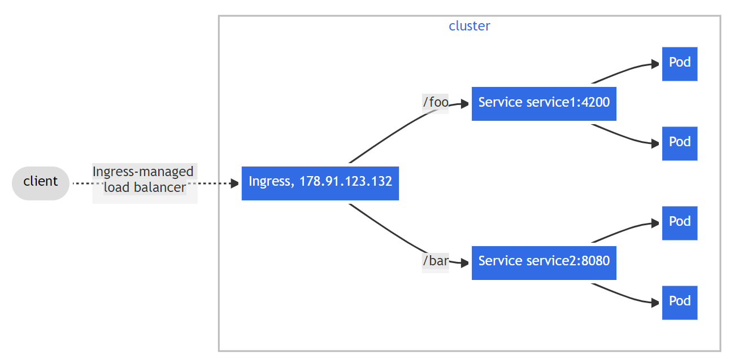
Ingress - Path based Routing

Slide 31
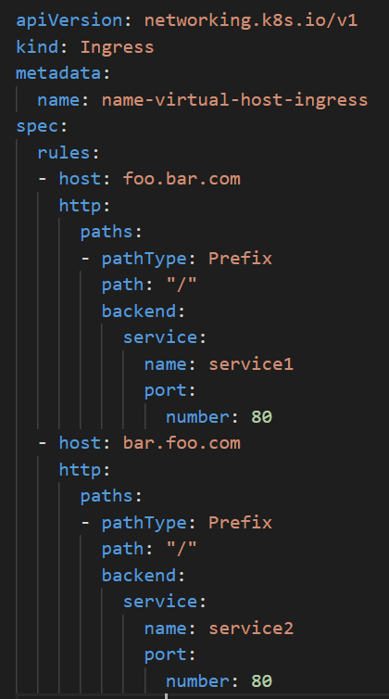
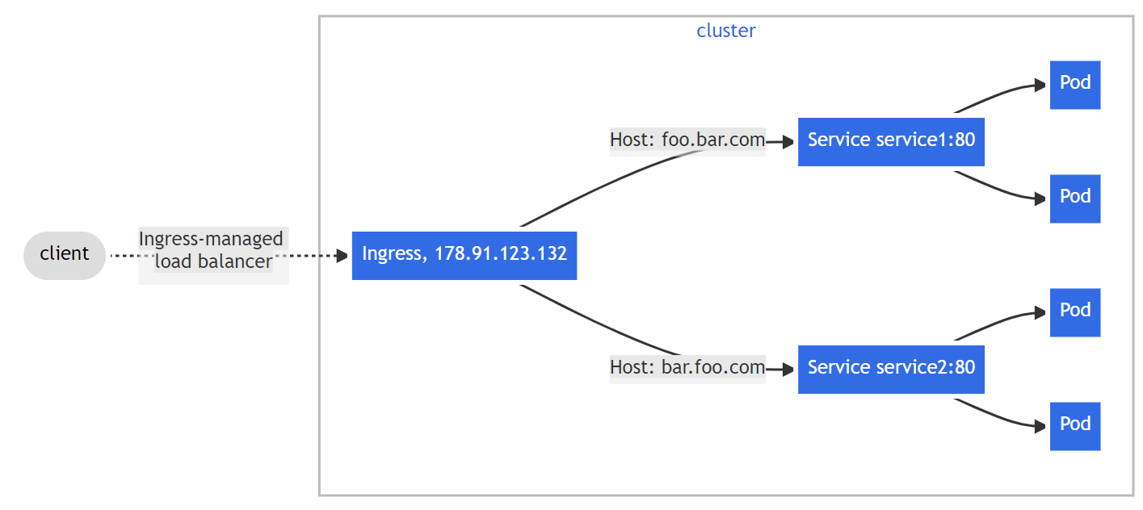
Ingress - Host based Routing

Slide 32
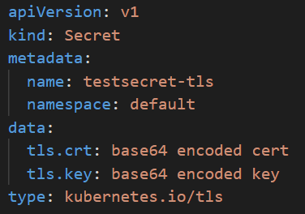
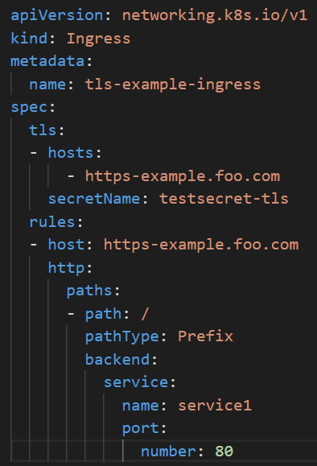
Ingress - TLS Termination

Slide 33
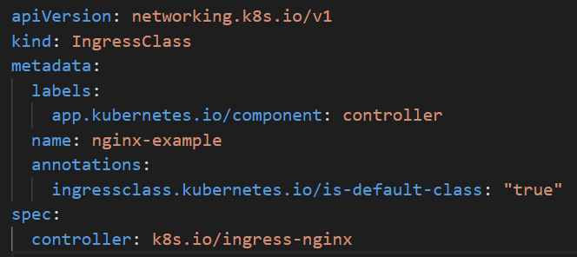
Ingress Controller
IngressClass
Common IC
Nginx IC
HAProxy IC
AWS LB Controller(formerly AWS ALB IC)
AKS Application Gateway IC

Slide 34
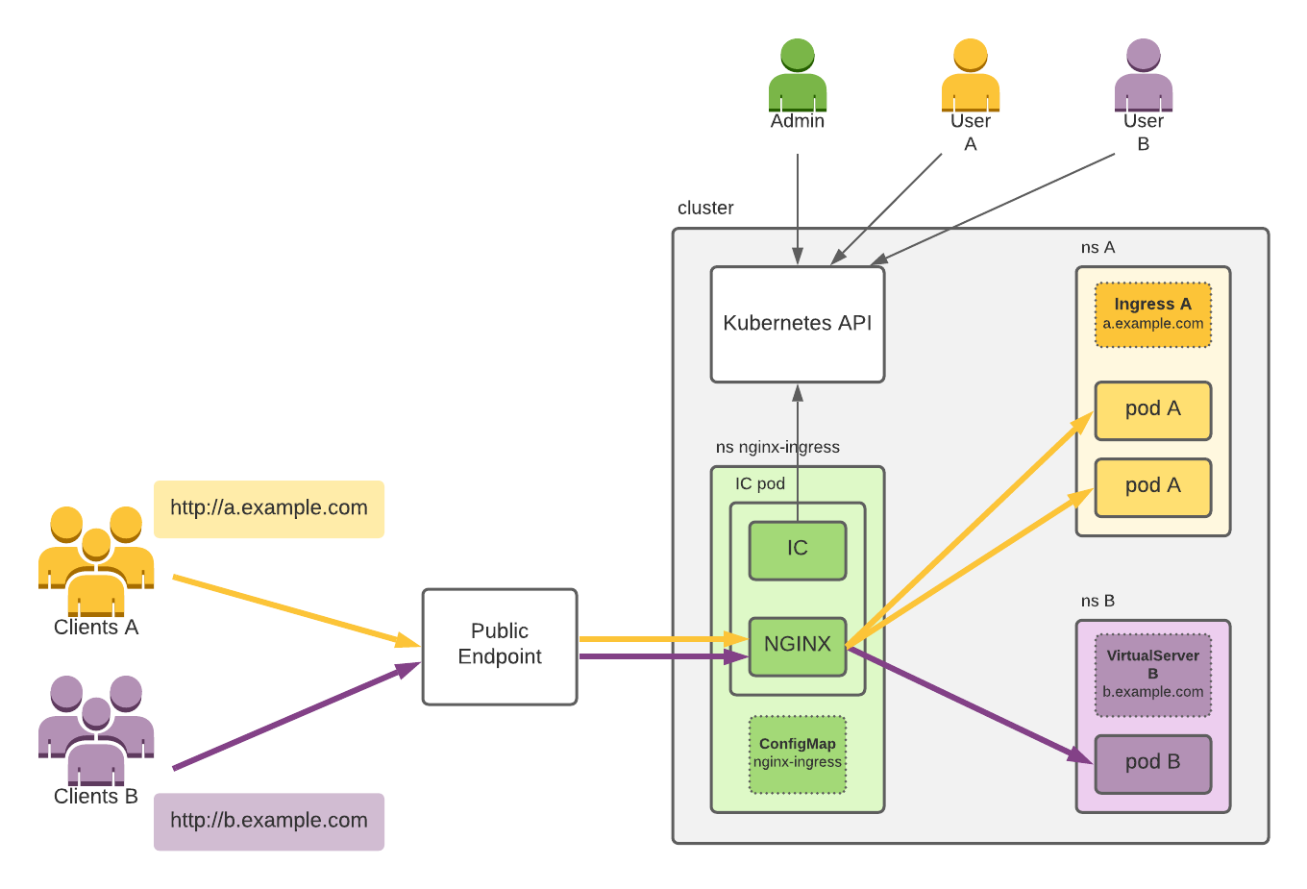
Nginx IC
Notes:
https://docs.nginx.com/nginx-ingress-controller/intro/how-nginx-ingress-controller-works/

Slide 35
AWS LB Controller
Notes:
https://kubernetes-sigs.github.io/aws-load-balancer-controller/v2.4/how-it-works/

Slide 36
Networking

Slide 37
Networking
Network problems to address
Container-to-Container in a Pod
Pod-to-Pod
Pod-to-Service
External-to-Service
K8S requirements on network implementation
Pods can communicate with all other pods on any other node without NAT
Agents on a node (e.g. system daemons, kubelet) can communicate with all pods on that node

Slide 38
CNI Implementation
Overlay
Flannel UDP/VXLAN
Routing
Flannel Host GW
Calico BGP
Underlay
AWS VPC CNI
Azure CNI

Slide 39
Overlay – Flannel UDP

Slide 40
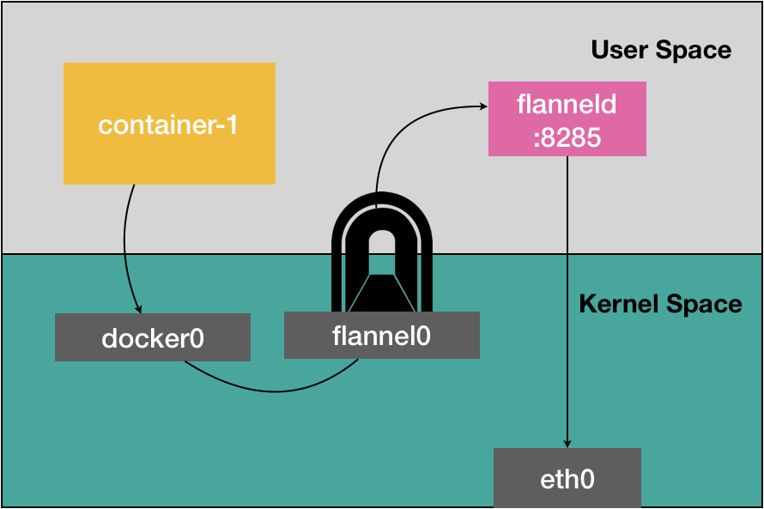
Overlay – Flannel UDP(cont.)
Problem

Slide 41
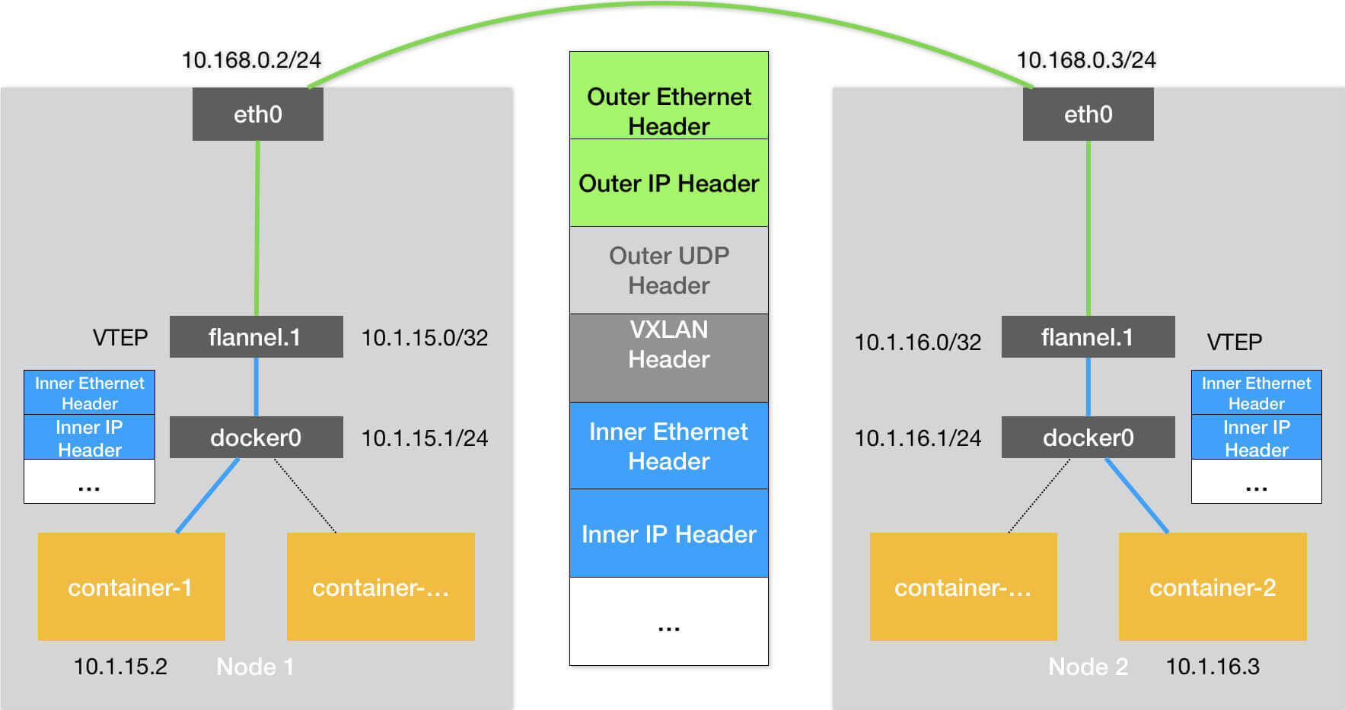
Overlay – Flannel VXLAN
Notes:
#get vtep MAC
$ ip neigh show dev flannel.1
10.1.16.0 lladdr 5e:f8:4f:00:e3:37 PERMANENT
#get dst IP (using Forwarding Database)
$ bridge fdb show flannel.1 | grep 5e:f8:4f:00:e3:37
5e:f8:4f:00:e3:37 dev flannel.1 dst 10.168.0.3 self permanent

Slide 42
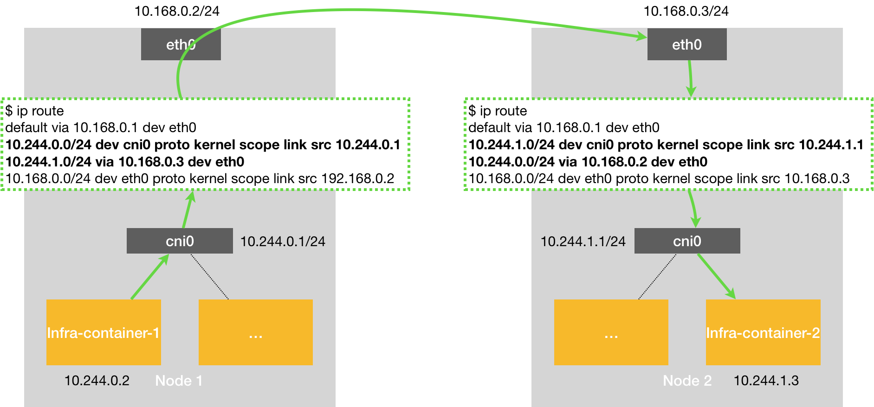
Routing – Flannel Host GW

Slide 43
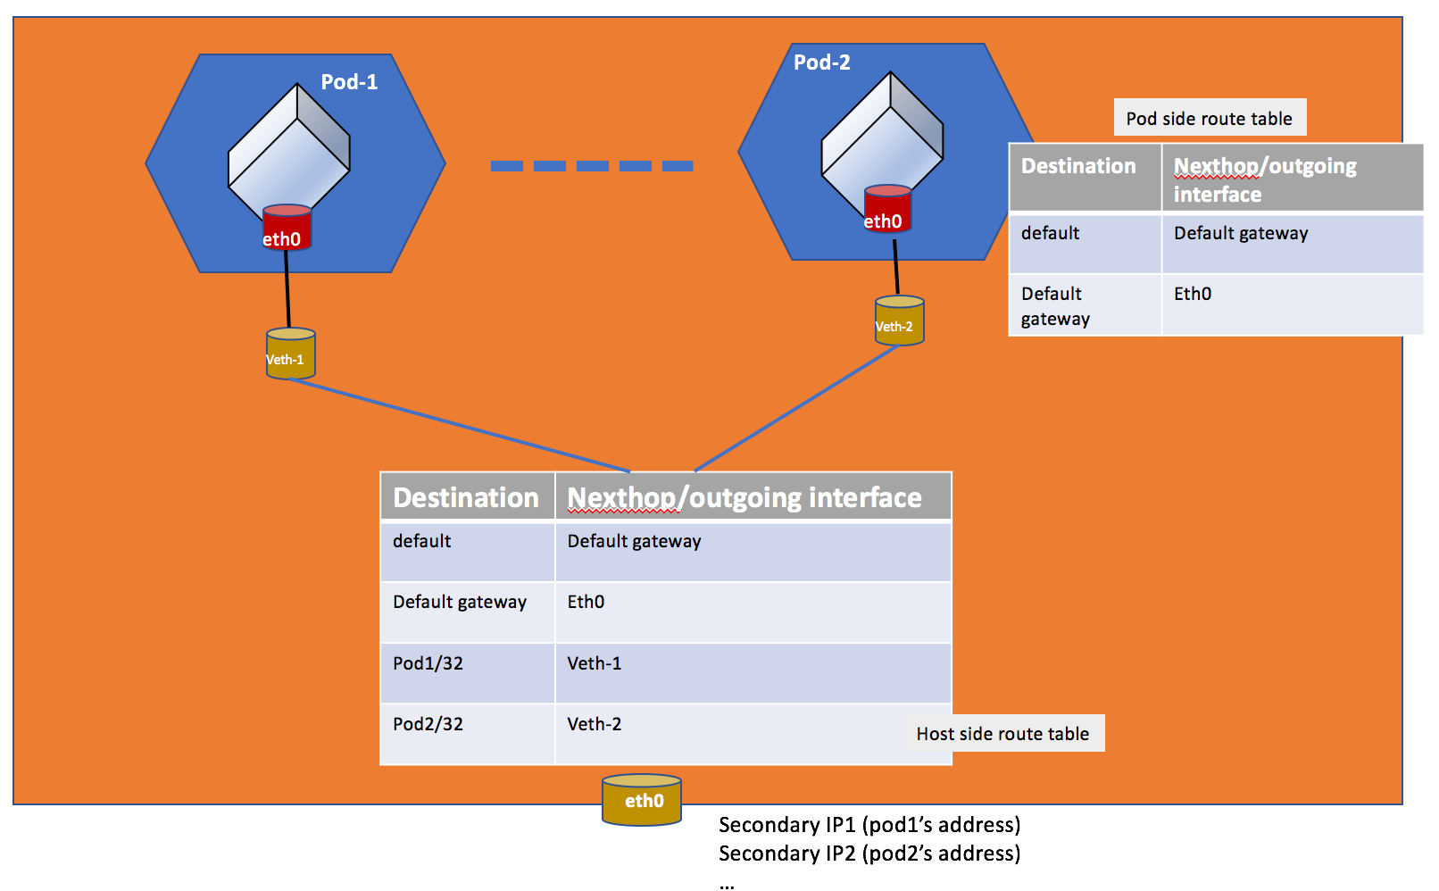
Underlay – AWS VPC CNI
Notes:
https://github.com/aws/amazon-vpc-cni-k8s/blob/master/docs/cni-proposal.md
https://aws.github.io/aws-eks-best-practices/networking/vpc-cni/
Amazon VPC CNI has two components:
CNI Binary, which will setup Pod network to enable Pod-to-Pod communication. The CNI binary runs on a node root file system and is invoked by the kubelet when a new Pod gets added to, or an existing Pod removed from the node.
ipamd, a long-running node-local IP Address Management (IPAM) daemon and is responsible for:
managing ENIs on a node, and
maintaining a warm-pool of available IP addresses or prefix

Slide 44
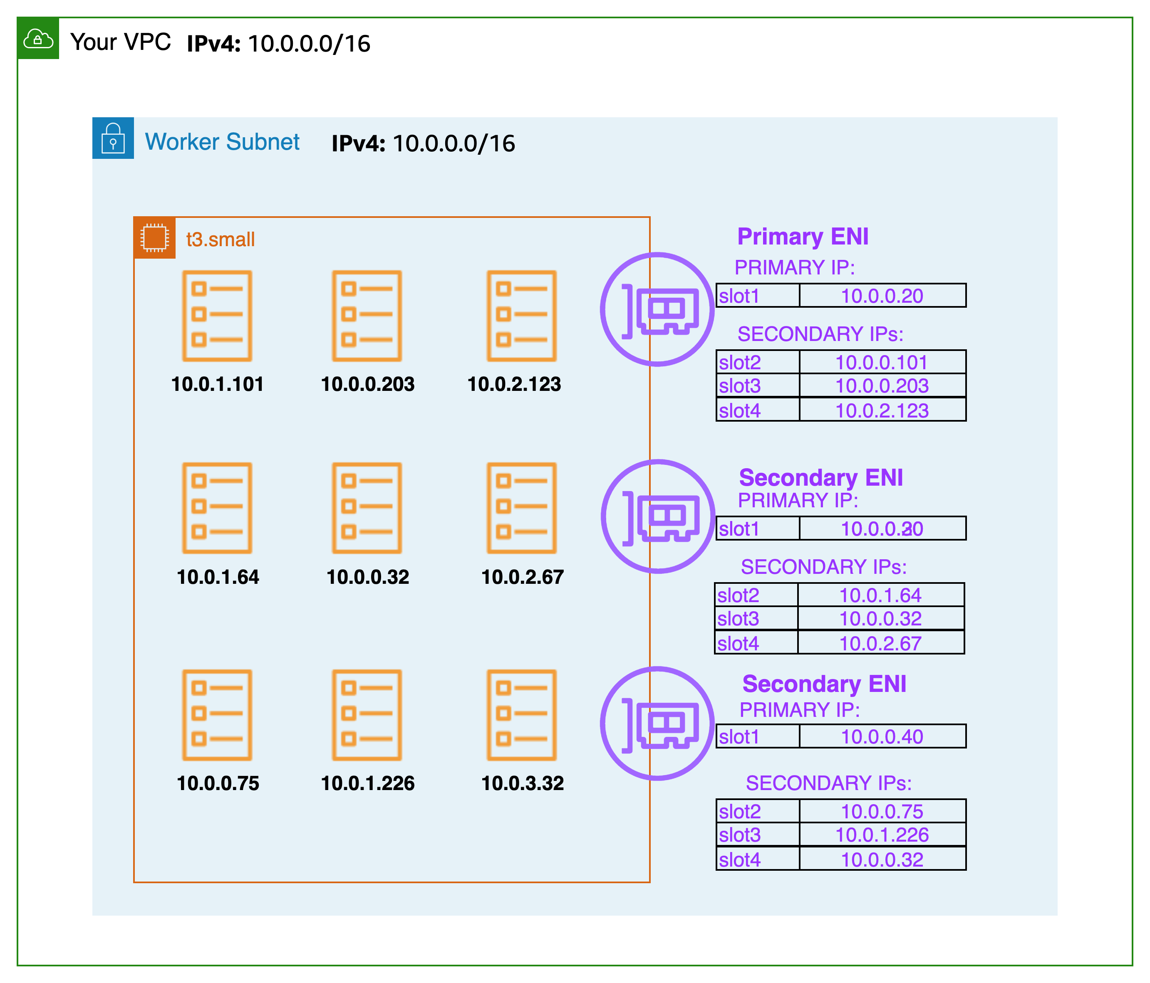
Underlay – AWS VPC CNI(cont.)
Default Mode
Secondary IP
Challenges
Limited IPs per node
Solution: Prefix Mode
Limited VPC CIDR size
Solution: Custom networking with secondary CIDR
Notes:
https://aws.github.io/aws-eks-best-practices/networking/index/
Formula: (Number of network interfaces for the instance type × (the number of IP addresses per network interface - 1)) + 2 , 2 refers to kube-proxy and VPC CNI

Slide 45
Security

Slide 46
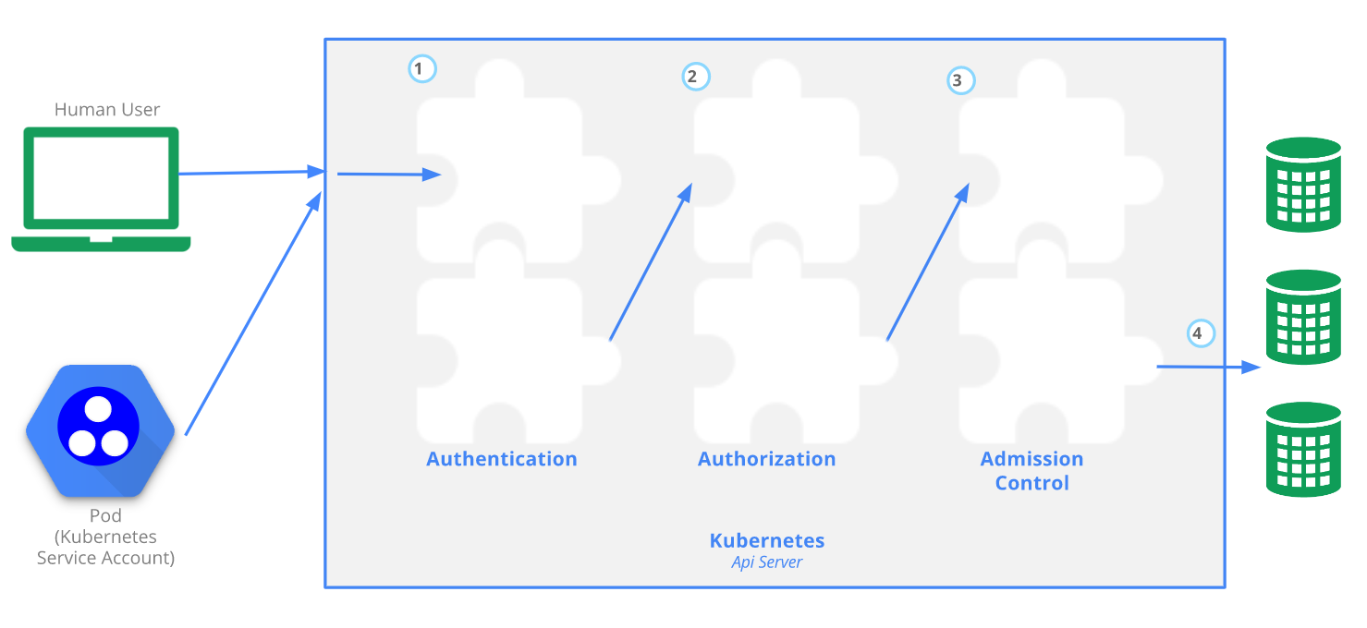
Security
apiserver access control
Notes:
The 4C's of Cloud Native security are Cloud, Clusters, Containers, and Code.
Here we focus on cluster security.
Admission controllers act on requests that create, modify, delete, or connect to (proxy) an object. Admission controllers may be "validating", "mutating", or both
E.g. NamespaceLifecycle:
Create objects in a non-existent namespace
Delete reserved namespace
E.g. Service Token Admission Control:
Set pod ServiceToken to defaut if not any
Add volume to a pod which contains a token for API access
-

Slide 47
Authentication
Normal User
K8S doesn’t have normal user objects
ServiceAccount
Each namespace has a “default” SA
Each Pod is assigned to default SA if spec.serviceAccountName is not set
Group
Authentication Strategy
X509 client cert
Bootstrap token
Service Account token
OIDC token
Webhook token authentication

Slide 48
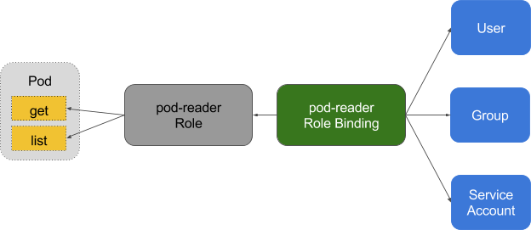
Authorization
RBAC
Subject
Role/ClusterRole
Default User-facing ClusterRole: cluster-admin/admin/edit/view
RoleBinding/ClusterRoleBinding
RoleBinding can work with ClusterRole

Slide 49
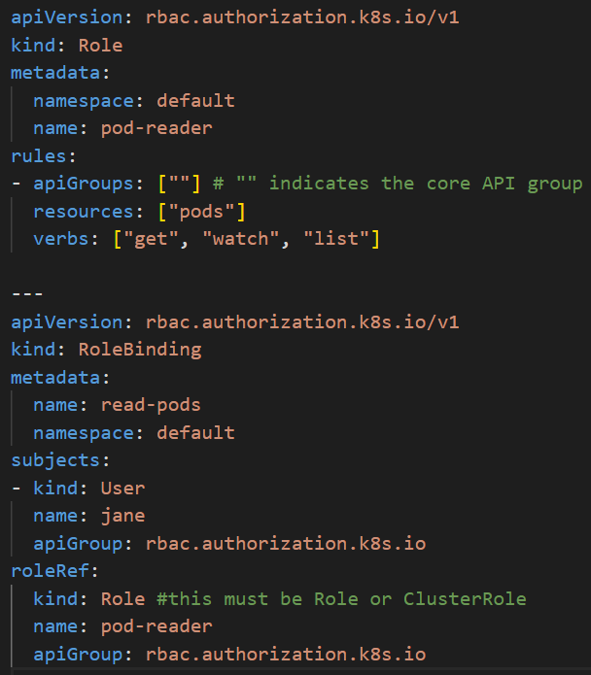

Authorization(cont.)

Slide 50

EKS - Authentication & Authorization
Notes:
Demo

Slide 51

EKS - IAM Role for Service Account
Notes:
demo

Slide 52
Storage

Slide 53
Storage
Volume Concept(OS/Docker/K8S)
Volume Type
Ephemeral | Persistent | Extension(CSI)
emptyDir configMap secret downwardAPI Projected …… | hostPath nfs local Cephfs persistentVolumeClaim ……. | AWS EBS CSI AWS EFS CSI azureDisk CSI azureFile CSI ……

Slide 54

emptyDir
By default it’s stored on disk
To store in memory:
Set emptyDir.medium to “memory”

Slide 55


ConfigMap
Define ConfigMap
Use ConfigMap
Mounted as volume
Mounted ConfigMaps are updated automatically
As environment variables
In container command & args

Slide 56


Secret
data & stringData
Secret Type
Opaque
basic-auth
ssh-auth
tls
……
Security
Enable Encryption at Rest
RBAC rules with least-privilege
Use external Secret store providers

Slide 57


Downward API
Motivation:
Expose Pod and container fields to a running container
Example
Indexed Job

Slide 58

Projected Volume
Motivation:
Mount different volume sources into the same folder
Supported sources:
secret
downwardAPI
configMap
serviceAccountToken

Slide 59

hostPath
Supported type
Directory/DirectoryOrCreate
File/FileOrCreate
Socket
CharDevice
BlockDevice

Slide 60
PVC/PV – Static Provision

Slide 61



PVC/PV – Dynamic Provision
StorageClass

Slide 62

CSI
K8S Persistent Storage Workflow:
Provision -> Attach -> Mount
Notes:
https://github.com/kubernetes/design-proposals-archive/blob/main/storage/container-storage-interface.md

Slide 63
Scheduling

Slide 64

Scheduling

Slide 65
Scheduling – Filter
Predicates
General
Resource usage/port conflict/nodeSelector/nodeAffinity
Volume related
Node related
Taint & Toleration
Pod related
podAffinity & podAntiAffinity
Notes:
Volume: ReadWriteOnce PV has been attached to one node. New pod using that PV need to assigned to that node

Slide 66


nodeSelector & nodeAffinity
nodeSelector
nodeAffinity

Slide 67

Taint & Toleration
Taint effect
NoSchedule
PreferNoSchedule
NoExecute
Use cases
Nodes with Special Hardware
Dedicated Nodes
Node maintenance
Control-plane related
Taint on master to prevent user pods from running on master
Taint on node with resource pressure, Tolerations of pressure taint by DaemonSet

Slide 68


podAffinity & podAntiAffinity

Slide 69
Scheduling – Scoring
Priorities Strategy Example
LeastRequestedPriority
BalancedResourceAllocation
score = (cpu((capacity-sum(requested))*10/capacity) + memory((capacity-sum(requested))*10/capacity))/2
score = 10 - variance(cpuFraction,memoryFraction,volumeFraction)*10

Slide 70
Eviction
Resource
Compressible vs Incompressible
Requests/Limits
QoS
Guaranteed: Each container has the same CPU&memory request and limit
Burstable: At least one container has a memory or CPU request or limit
BestEffort： No any CPU or memory request/limit
Eviction
kubelet eviction: short of incompressible resource
Order: BestEffort -> Burstable -> Guaranteed (Also check Pod priority & resource usage)
Soft vs Hard eviction

Slide 71
Application & Cluster Mgmt.

Slide 72

Autoscaling - HPA

Slide 73
Autoscaling – HPA(Cont.)
Metric type
Resource metric
Custom metric: reported from applications running in K8S
e.g. queries per secod, writes per second
External metric: reported from outside K8S cluster
e.g. undelivered message num
Metric provider example
Metric server
Prometheus Adapter
k8s-cloudwatch-adapter

Slide 74
Autoscaling – CA & VPA
Cluster Autoscaler
Automatically adjusts the number of nodes of a cluster
Vertical Pod Autoscaler
Automatically adjusts/suggests resources needed by containers

Slide 75

Helm
Helm: Package manager for K8S
Concepts:
Chart/Repository/Release
Chart file structure

Slide 76


CRD

Slide 77
Operator
Operator
Software extensions to Kubernetes that make use of custom resources to manage applications and their components
Use automation to take care of repeatable tasks
Example SampleDB Operator
CR: SampleDB
Custom controller with control loop run as deployment
Add: Set up PVC and create StatefulSet
Delete: take snapshot and remove volume & StatefulSet
Do regular backups
Upgrade DB version

Slide 78


Logging
Option 1
Option 2

Slide 79
Summary
Architecture
Pod & Workload Resources
Service & Ingress
Networking
Security
Storage
Scheduling
Application & Cluster Mgmt.

Slide 80
Practice

Slide 81
Practice
Practice: https://wiki.jarvis.trendmicro.com/display/~evan_wang/Practice%3A+Head+First+Kubernetes
Kubectl Autocompletion: https://kubernetes.io/docs/tasks/tools/included/optional-kubectl-configs-bash-linux/

